Slide 1
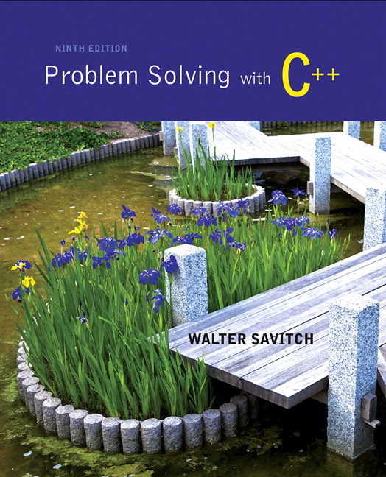
Problem Solving with C++ by Walter Savitch

Slide 2
Chapter 8
Strings and Vectors

Slide 3
Overview
8.1 An Array Type for Strings
8.2 The Standard string Class
8.3 Vectors

Slide 4
8.1
An Array Type for Strings

Slide 5
An Array Type for Strings
C-strings can be used to represent strings of characters
C-strings are stored as arrays of characters
C-strings use the null character '\0' to end a string
The Null character is a single character
To declare a C-string variable, declare an array of characters: char s[11];

Slide 6
C-string Details
Declaring a C-string as char s[10] creates space for only nine characters
The null character terminator requires one space
A C-string variable does not need a size variable
The null character immediately follows the last character of the string
Example:
s[0] | s[1] | s[2] | s[3] | s[4] | s[5] | s[6] | s[7] | s[8] | s[9]
H | i |  | M | o | m | ! | \0 | ? | ?

Slide 7
C-string Declaration
To declare a C-string variable, use the syntax: char Array_name[ Maximum_C_String_Size + 1];
+ 1 reserves the additional character needed by '\0'

Slide 8
Initializing a C-string
To initialize a C-string during declaration: char my_message[20] = "Hi there.";
The null character '\0' is added for you
Another alternative: char short_string[ ] = "abc"; but not this: char short_string[ ] = {'a', 'b', 'c'};

Slide 9
C-string error
This attempt to initialize a C-string does not cause the \0 to be inserted in the array
char short_string[ ] = {'a', 'b', 'c'};

Slide 10
Don't Change '\0'
Do not to replace the null character when manipulating indexed variables in a C-string
If the null character is lost, the array cannot act like a C-string
Example: int index = 0; while (our_string[index] != '\0') { our_string[index] = 'X'; index++; }
This code depends on finding the null character!

Slide 11
Safer Processing of C-strings
The loop on the previous slide depended on finding the '\0' character
It would be wiser to use this version in case the '\0' character had been removed int index = 0; while (our_string[index] != '\0' && index < SIZE) { our_string[index] = 'X'; index++; }

Slide 12
Assignment With C-strings
This statement is illegal: a_string = "Hello";
This is an assignment statement, not an initialization
The assignment operator does not work with C-strings

Slide 13
Assignment of C-strings
A common method to assign a value to a C-string variable is to use strcpy, defined in the cstring library
Example: #include <cstring> … char a_string[ 11]; strcpy (a_string, "Hello"); Places "Hello" followed by the null character in a_string

Slide 14
A Problem With strcpy
strcpy can create problems if not used carefully
strcpy does not check the declared length of the first argument
It is possible for strcpy to write characters beyond the declared size of the array

Slide 15
A Solution for strcpy
Many versions of C++ have a safer version of strcpy named strncpy
strncpy uses a third argument representing the maximum number of characters to copy
Example: char another_string[10]; strncpy(another_string, a_string_variable, 9); This code copies up to 9 characters into another_string, leaving one space for '\0'

Slide 16
== Alternative for C-strings
The == operator does not work as expected with C-strings
The predefined function strcmp is used to compare C-string variables
Example: #include <cstring> … if (strcmp(c_string1, c_string2)) cout << "Strings are not the same."; else cout << "String are the same.";

Slide 17
strcmp's logic
strcmp compares the numeric codes of elements in the C-strings a character at a time
If the two C-strings are the same, strcmp returns 0
0 is interpreted as false
As soon as the characters do not match
strcmp returns a negative value if the numeric code in the first parameter is less
strcmp returns a positive value if the numeric code in the second parameter is less
Non-zero values are interpreted as true

Slide 18
More C-string Functions
The cstring library includes other functions
strlen returns the number of characters in a string int x = strlen( a_string);
strcat concatenates two C-strings
The second argument is added to the end of the first
The result is placed in the first argument
Example: char string_var[20] = "The rain"; strcat(string_var, "in Spain"); Now string_var contains "The rainin Spain"

Slide 19
The strncat Function
strncat is a safer version of strcat
A third parameter specifies a limit for the number of characters to concatenate
Example:
char string_var[20] = "The rain"; strncat(string_var, "in Spain", 11);
Display 8.1 (1)
Display 8.1 (2)

Slide 20
C-strings as Arguments and Parameters
C-string variables are arrays
C-string arguments and parameters are used just like arrays
If a function changes the value of a C-string parameter, it is best to include a parameter for the declared size of the C-string
If a function does not change the value of a C-string parameter, the null character can detect the end of the string and no size argument is needed

Slide 21
C-string Output
C-strings can be output with the insertion operator
Example: char news[ ] = "C-strings"; cout << news << " Wow." << endl;

Slide 22
C-string Input
The extraction operator >> can fill a C-string
Whitespace ends reading of data
Example: char a[80], b[80]; cout << "Enter input: " << endl; cin >> a >> b; cout << a << b << "End of Output"; could produce: Enter input: Do be do to you! DobeEnd of Output

Slide 23
Reading an Entire Line
Predefined member function getline can read an entire line, including spaces
getline is a member of all input streams
getline has two arguments
The first is a C-string variable to receive input
The second is an integer, usually the size of the first argument specifying the maximum number of elements in the first argument getline is allowed to fill

Slide 24
Using getline
The following code is used to read an entire line including spaces into a single C-string variable
char a[80]; cout << "Enter input:\n"; cin.getline(a, 80); cout << a << End Of Output\n"; and could produce: Enter some input: Do be do to you! Do be do to you!End of Output

Slide 25
getline wrap up
getline stops reading when the number of characters, less one, specified in the second argument have been placed in the C-string
one character is reserved for the null character
getline stops even if the end of the line has not been reached

Slide 26
getline and Files
C-string input and output work the same way with file streams
Replace cin with the name of an input-file stream in_stream >> c_string; in_stream.getline(c_string, 80);
Replace cout with the name of an output-file stream out_stream << c_string;

Slide 27
getline syntax
Syntax for using getline is cin.getline(String_Var, Max_Characters + 1);
cin can be replaced by any input stream
Max_Characters + 1 reserves one element for the null character

Slide 28
C-String to Numbers
"1234" is a string of characters
1234 is a number
When doing numeric input, it is useful to read input as a string of characters, then convert the string to a number
Reading money may involve a dollar sign
Reading percentages may involve a percent sign

Slide 29
C-strings to Integers
To read an integer as characters
Read input as characters into a C-string, removing unwanted characters
Use the predefined function atoi to convert the C-string to an int value
Example: atoi("1234") returns the integer 1234 atoi("#123") returns 0 because # is not a digit

Slide 30
C-string to long
Larger integers can be converted using the predefined function atol
atol returns a value of type long

Slide 31
C-string to double
C-strings can be converted to type double using the predefined function atof
atof returns a value of type double
Example: atof("9.99") returns 9.99 atof("$9.99") returns 0.0 because the $ is not a digit

Slide 32
Library cstdlib
The conversion functions atoi atol atof are found in the library cstdlib
To use the functions use the include directive #include <cstdlib>

Slide 33
Numeric Input
We now know how to convert C-strings to numbers
How do we read the input?
Function read_and_clean, in Display 8.2…
Reads a line of input
Discards all characters other than the digits '0' through '9'
Uses atoi to convert the "cleaned-up" C-string to int
Display 8.2 (1)
Display 8.2 (2)

Slide 34
Confirming Input
Function get_int, from Display 8.3…
Uses read_and_clean to read the user's input
Allows the user to reenter the input until the user is satisfied with the number computed from the input string
Display 8.3 (1)
Display 8.3 (2)

Slide 35
Section 8.1 Conclusion
Can you
Describe the benefits of reading numeric data as characters before converting the characters to a number?
Write code to do input and output with C-strings?
Use the atoi, atol, and atof functions?
Identify the character that ends a C-string?

Slide 36
8.2
The Standard string Class

Slide 37
The Standard string Class
The string class allows the programmer to treat strings as a basic data type
No need to deal with the implementation as with C-strings
The string class is defined in the string library and the names are in the standard namespace
To use the string class you need these lines: #include <string> using namespace std;

Slide 38
Assignment of Strings
Variables of type string can be assigned with the = operator
Example: string s1, s2, s3; … s3 = s2;
Quoted strings are type cast to type string
Example: string s1 = "Hello Mom!";

Slide 39
Using + With strings
Variables of type string can be concatenated with the + operator
Example: string s1, s2, s3; … s3 = s1 + s2;
If s3 is not large enough to contain s1 + s2, more space is allocated

Slide 40
string Constructors
The default string constructor initializes the string to the empty string
Another string constructor takes a C-string argument
Example: string phrase; // empty string string noun("ants"); // a string version // of "ants"

Slide 41
Mixing strings and C-strings
It is natural to work with strings in the following manner string phrase = "I love" + adjective + " " + noun + "!";
It is not so easy for C++! It must either convert the null-terminated C-strings, such as "I love", to strings, or it must use an overloaded + operator that works with strings and C-strings
Display 8.4

Slide 42
I/O With Class string
The insertion operator << is used to output objects of type string
Example: string s = "Hello Mom!"; cout << s;
The extraction operator >> can be used to input data for objects of type string
Example: string s1; cin >> s1;
>> skips whitespace and stops on encountering more whitespace

Slide 43
getline and Type string
A getline function exists to read entire lines into a string variable
This version of getline is not a member of the istream class, it is a non-member function
Syntax for using this getline is different than that used with cin: cin.getline(…)
Syntax for using getline with string objects: getline(Istream_Object, String_Object);

Slide 44
getline Example
This code demonstrates the use of getline with string objects
string line; cout "Enter a line of input:\n"; getline(cin, line); cout << line << "END OF OUTPUT\n"; Output could be: Enter some input: Do be do to you! Do be do to you!END OF OUTPUT

Slide 45
Character Input With strings
The extraction operator cannot be used to read a blank character
To read one character at a time remember to use cin.get
cin.get reads values of type char, not type string
The use of getline, and cin.get for string input are demonstrated in
Display 8.5 (1)
Display 8.5 (2)

Slide 46
Another Version of getline
The versions of getline we have seen, stop reading at the end of line marker '\n'
getline can stop reading at a character specified in the argument list
This code stops reading when a '?' is read string line; cout <<"Enter some input: \n"; getline(cin, line, '?');

Slide 47
getline Returns a Reference
getline returns a reference to its first argument
This code will read in a line of text into s1 and a string of non-whitespace characters into s2: string s1, s2; getline(cin, s1) >> s2;
cin >> s2;
returns

Slide 48
getline Declarations
These are the declarations of the versions of getline for string objects we have seen
istream& getline(istream& ins, string& str_var, char delimiter);
istream& getline(istream& ins, string& str_var);

Slide 49
Mixing cin >> and getline
Recall cin >> n skips whitespace to find what it is to read then stops reading when whitespace is found
cin >> leaves the '\n' character in the input stream
Example: int n; string line; cin >> n; getline(cin, line); leaves the '\n' which immediately ends getline's reading…line is set equal to the empty string

Slide 50
ignore
ignore is a member of the istream class
ignore can be used to read and discard all the characters, including '\n' that remain in a line
Ignore takes two arguments
First, the maximum number of characters to discard
Second, the character that stops reading and discarding
Example: cin.ignore(1000, '\n'); reads up to 1000 characters or to '\n'

Slide 51
String Processing
The string class allows the same operations we used with C-strings…and more
Characters in a string object can be accessed as if they are in an array
last_name[i] provides access to a single character as in an array
Index values are not checked for validity!
Display 8.6

Slide 52
Member Function length
The string class member function length returns the number of characters in the string object:
Example: int n = string_var.length( );

Slide 53
Member Function at
at is an alternative to using [ ]'s to access characters in a string.
at checks for valid index values
Example:
string str("Mary"); cout << str[6] << endl; cout << str.at(6) << endl; str[2] = 'X'; str.at(2) = 'X';
Equivalent
Equivalent
Other string class functions are found in
Display 8.7

Slide 54
string class to numbers
C++11 has new functions to convert a string class object to a number
int i; double d; string s; i = stoi("35"); // Converts the string "35" to an integer 35 d = stod("2.5"); // Converts the string "2.5" to the double 2.5
C++11 has new functions to convert a string class object to a number
string s = to_string(1.2*2); // “2.4” stored in s

Slide 55
Comparison of strings
Comparison operators work with string objects
Objects are compared using lexicographic order (Alphabetical ordering using the order of symbols in the ASCII character set.)
== returns true if two string objects contain the same characters in the same order
Remember strcmp for C-strings?
<, >, <=, >= can be used to compare string objects

Slide 56
Program Example: Palindrome Testing
A palindrome is a string that reads the same from front to back as it does from back to front
This program ignores spaces and punctuation
Upper and lowercase versions of letters are considered the same letter
Examples: Able was I 'ere I saw Elba. Madam, I'm Adam. A man, a plan, a canal, Panama. Racecar

Slide 57
Palindrome Testing: remove_punct
remove_punct removes punctuation from a string
remove_punct compares each character in the string to the characters in a string containing all the punctuation characters and the space character.
If a match is not found, the character is added to the string no_punct
no_punct, the original string less any punctuation or spaces, is returned

Slide 58
Palindrome Testing: substr
The substr member function is used to locate a substring within a string
remove_punct uses substr to extract a single character at a time from the source string. The character is stored in a_char.
remove_punct then uses function find to see if the character in a_char is in the string of punctuation characters

Slide 59
Palindrome Testing: The Program
The entire palindrome testing program is found in
Display 8.8 (1)
Display 8.8 (2)
Display 8.8 (3)
Display 8.8 (4)

Slide 60
string Objects to C-strings
Recall the automatic conversion from C-string to string: char a_c_string[] = "C-string"; string_variable = a_c_string;
strings are not converted to C-strings
Both of these statements are illegal:
a_c_string = string_variable;
strcpy(a_c_string, string_variable);

Slide 61
Converting strings to C-strings
The string class member function c_str returns the C-string version of a string object
Example: strcpy(a_c_string, string_variable.c_str( ) );
This line is still illegal a_c_string = string_variable.c_str( ) ;
Recall that operator = does not work with C-strings

Slide 62
Section 8.2 Conclusion
Can you
Show how a string object can be used like a C-string?
Write code to read an entire line into a string object?
Use the string function at to access individual characters in a string object?
Write code to convert a string to a C-string?

Slide 63
8.3
Vectors

Slide 64
Vectors
Vectors are like arrays that can change size as your program runs
Vectors, like arrays, have a base type
To declare an empty vector with base type int: vector<int> v;
<int> identifies vector as a template class
You can use any base type in a template class: vector<string> v;

Slide 65
Accessing vector Elements
Vectors elements are indexed starting with 0
[ ]'s are used to read or change the value of an item: v[i] = 42; cout << v[i];
[ ]'s cannot be used to initialize a vector element

Slide 66
Initializing vector Elements
Elements are added to a vector using the member function push_back
push_back adds an element in the next available position
Example: vector<double> sample; sample.push_back(0.0); sample.push_back(1.1); sample.push_back(2.2);

Slide 67
The size Of A vector
The member function size returns the number of elements in a vector
Example: To print each element of a vector given the previous vector initialization: for (int i= 0; i < sample.size( ); i++) cout << sample[i] << endl;

Slide 68
The Type unsigned int
The vector class member function size returns an unsigned int
Unsigned int's are nonnegative integers
Some compilers will give a warning if the previous for-loop is not changed to: for (unsigned int i= 0; i < sample.size( ); i++) cout << sample[i] << endl;

Slide 69
Alternate vector Initialization
A vector constructor exists that takes an integer argument and initializes that number of elements
Example: vector<int> v(10); initializes the first 10 elements to 0 v.size( ) would return 10
[ ]'s can now be used to assign elements 0 through 9
push_back is used to assign elements greater than 9

Slide 70
Vector Initialization With Classes
The vector constructor with an integer argument
Initializes elements of number types to zero
Initializes elements of class types using the default constructor for the class

Slide 71
The vector Library
To use the vector class
Include the vector library #include <vector>
Vector names are placed in the standard namespace so the usual using directive is needed: using namespace std;
Display 8.9

Slide 72
vector Issues
Attempting to use [ ] to set a value beyond the size of a vector may not generate an error
The program will probably misbehave
The assignment operator with vectors does an element by element copy of the right hand vector
For class types, the assignment operator must make independent copies

Slide 73
vector Efficiency
A vector's capacity is the number of elements allocated in memory
Accessible using the capacity( ) member function
Size is the number of elements initialized
When a vector runs out of space, the capacity is automatically increased
A common scheme is to double the size of a vector
More efficient than allocating smaller chunks of memory

Slide 74
Controlling vector Capacity
When efficiency is an issue
Member function reserve can increase the capacity of a vector
Example:
v.reserve(32); // at least 32 elements v.reserve(v.size( ) + 10); // at least 10 more
resize can be used to shrink a vector
Example: v.resize(24);
//elements beyond 24 are lost

Slide 75
Section 8.3 Conclusion
Can you
Declare and initialize a vector of 10 doubles?
Write code to increase the size of a vector in at least two different ways?
Describe the difference between a vector's size and its capacity?

Slide 76
Chapter 8 -- End

Slide 77
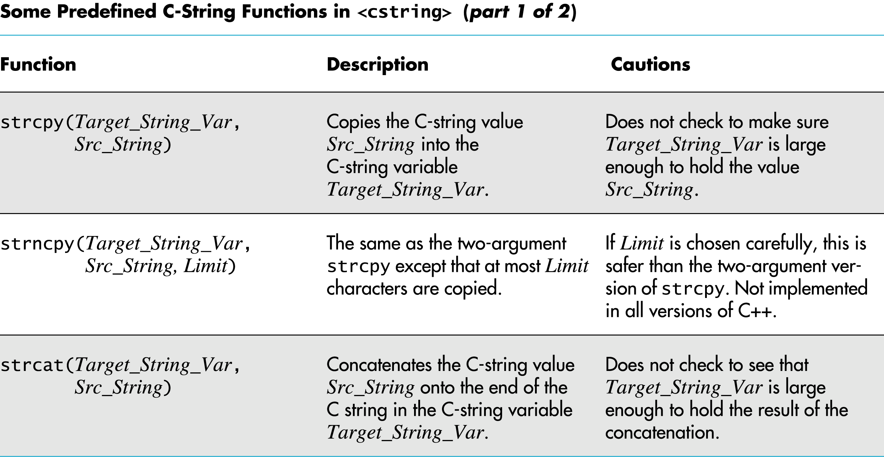
Display 8.1 (1/2)
Back
Next

Slide 78
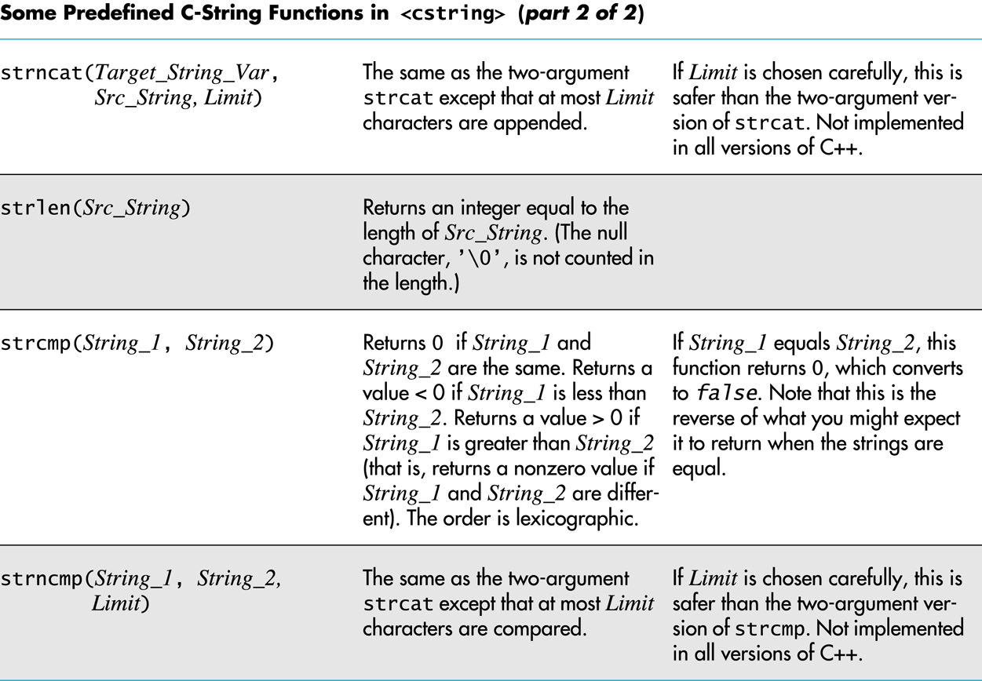
Display 8.1 (2/2)
Back
Next

Slide 79
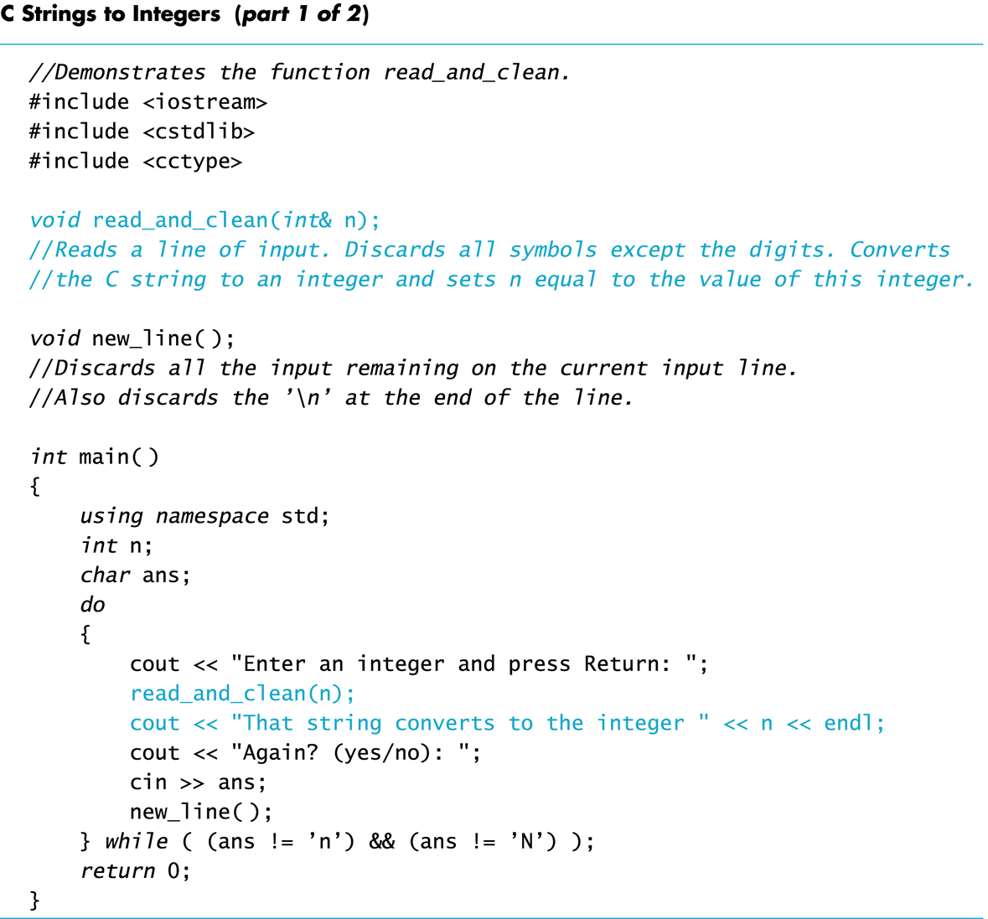
Display 8.2 (1/2)
Back
Next

Slide 80
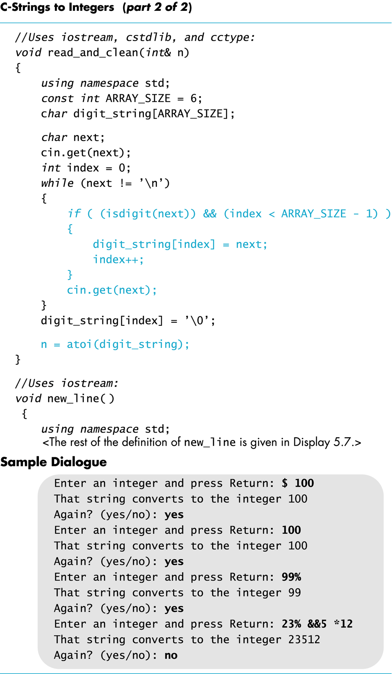
Display 8.2 (2/2)
Back
Next

Slide 81
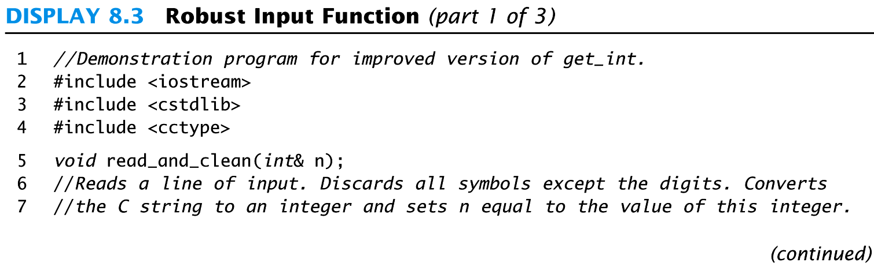
Display 8.3 (1/3)
Back
Next

Slide 82
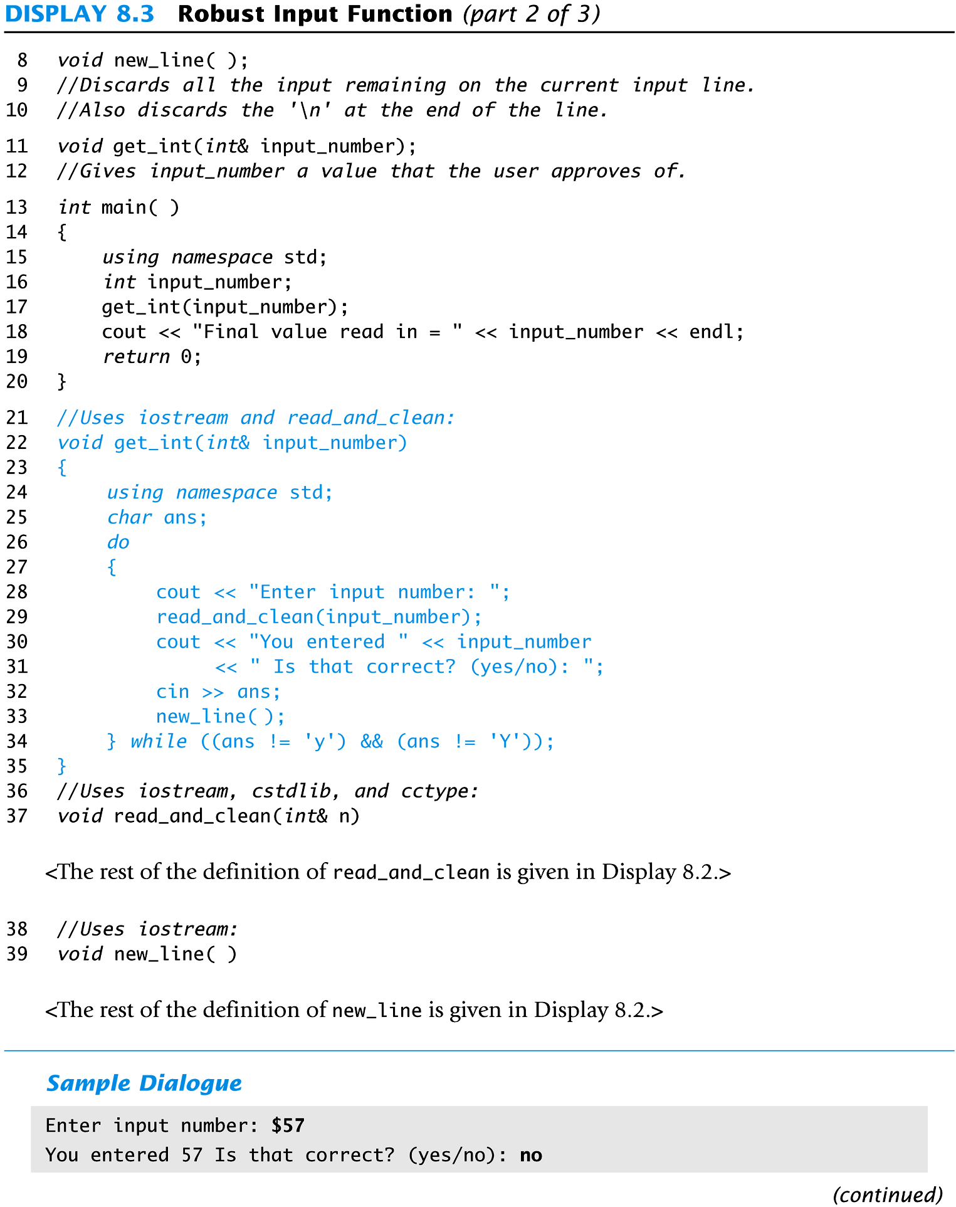
Display 8.3 (2/3)
Back
Next

Slide 83
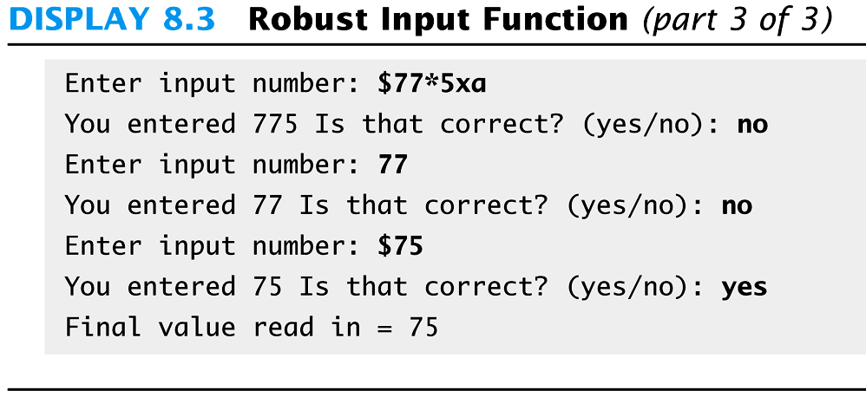
Display 8.3 (3/3)
Back
Next

Slide 84
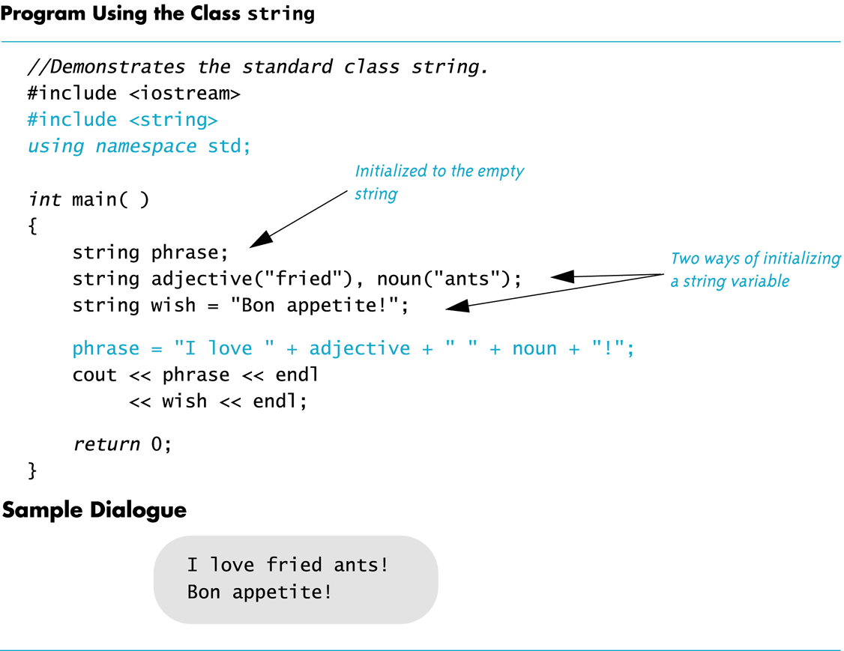
Display 8.4
Back
Next

Slide 85
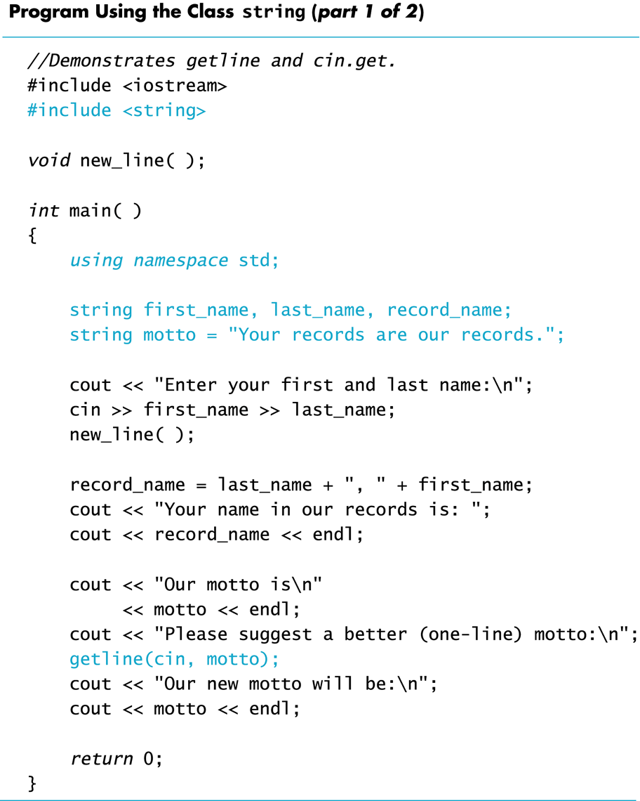
Display 8.5 (1/2)
Back
Next

Slide 86
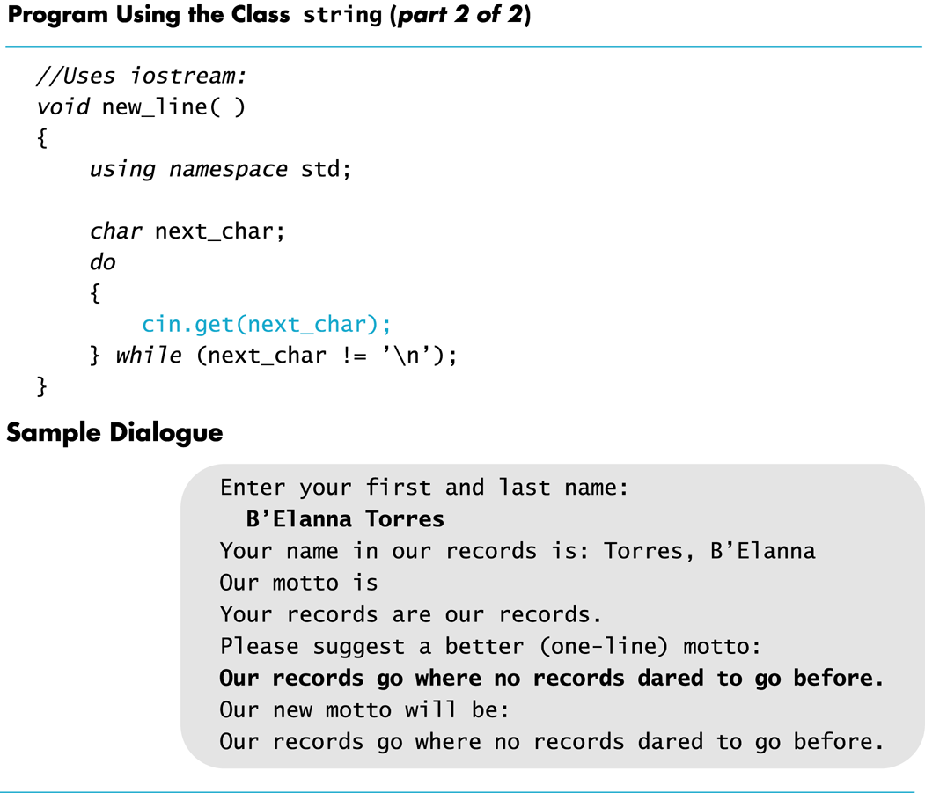
Display 8.5 (2/2)
Back
Next

Slide 87
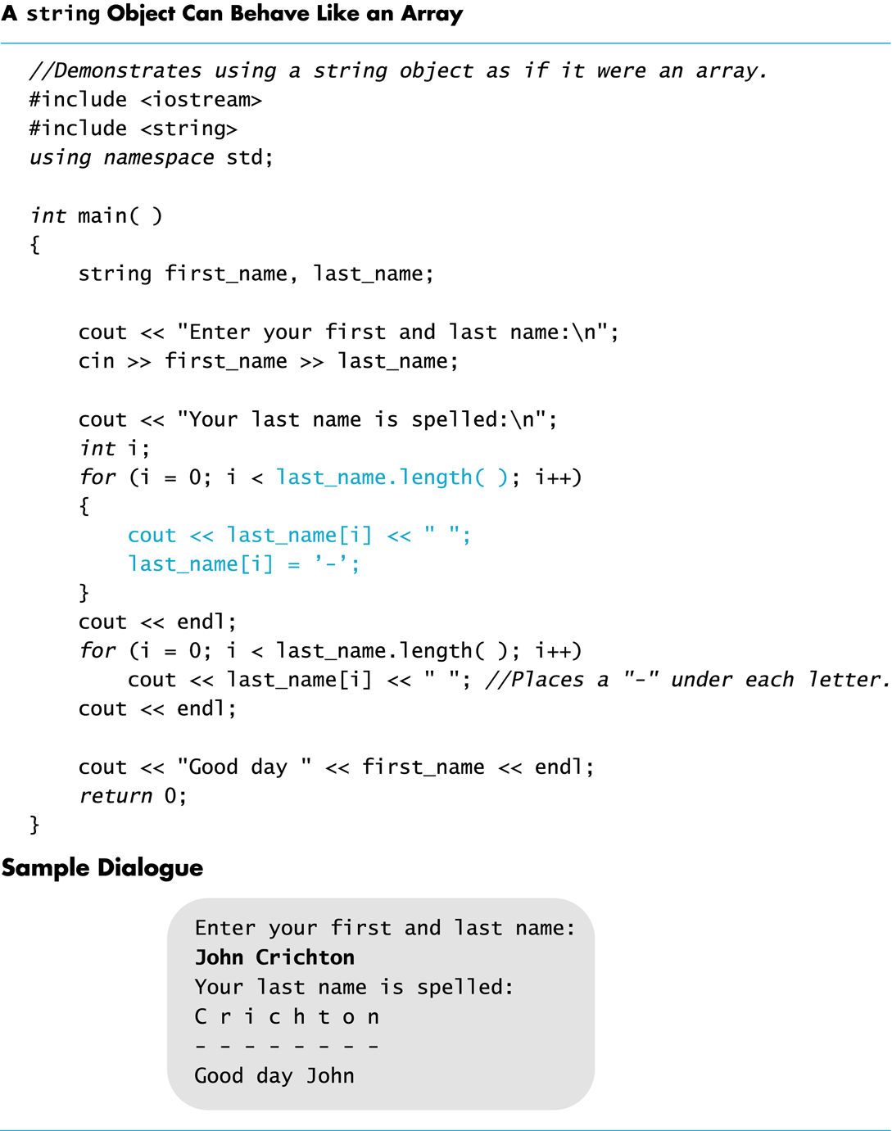
Display 8.6
Back
Next

Slide 88
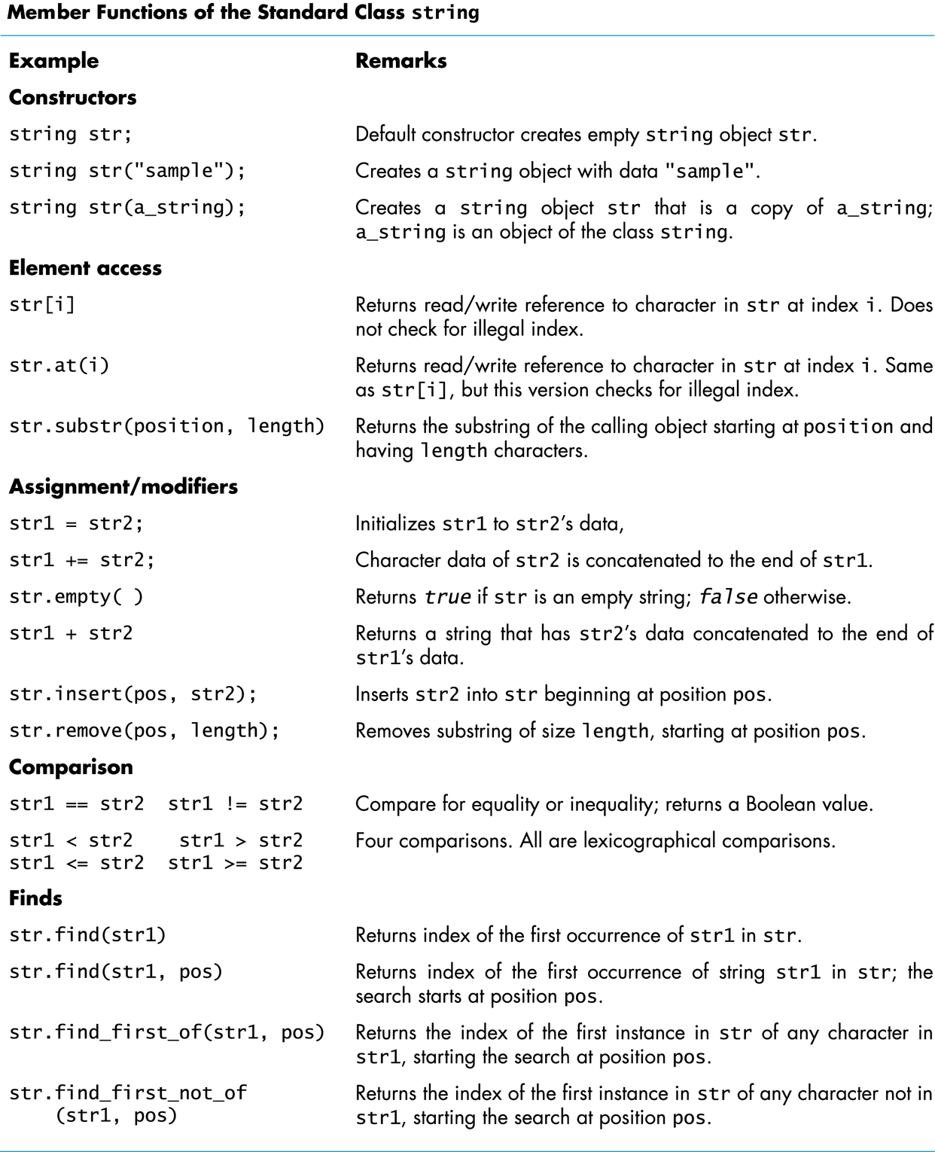
Display 8.7
Back
Next

Slide 89
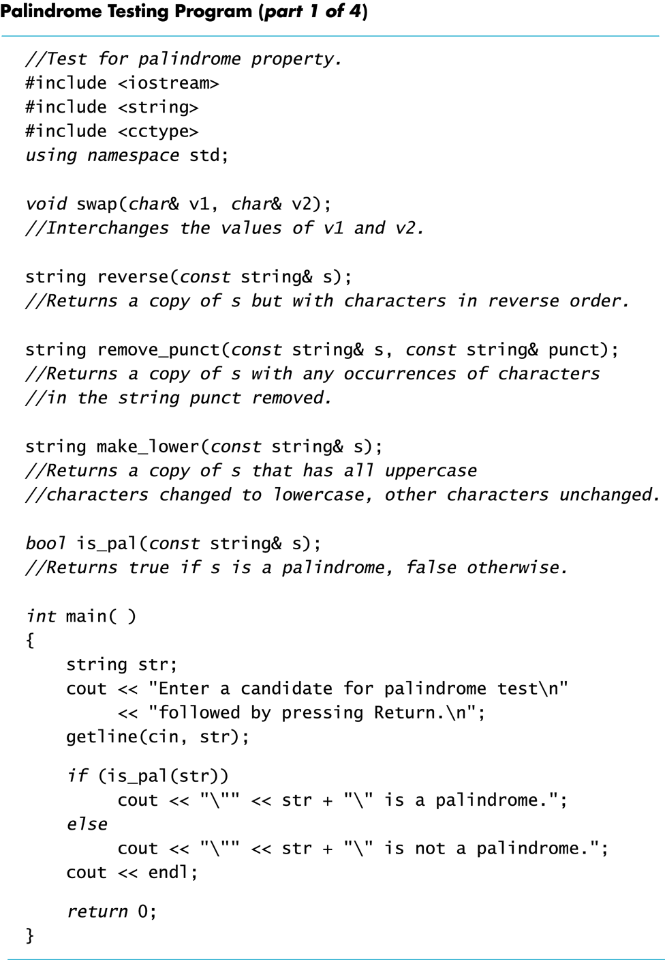
Display 8.8 (1/4)
Back
Next

Slide 90
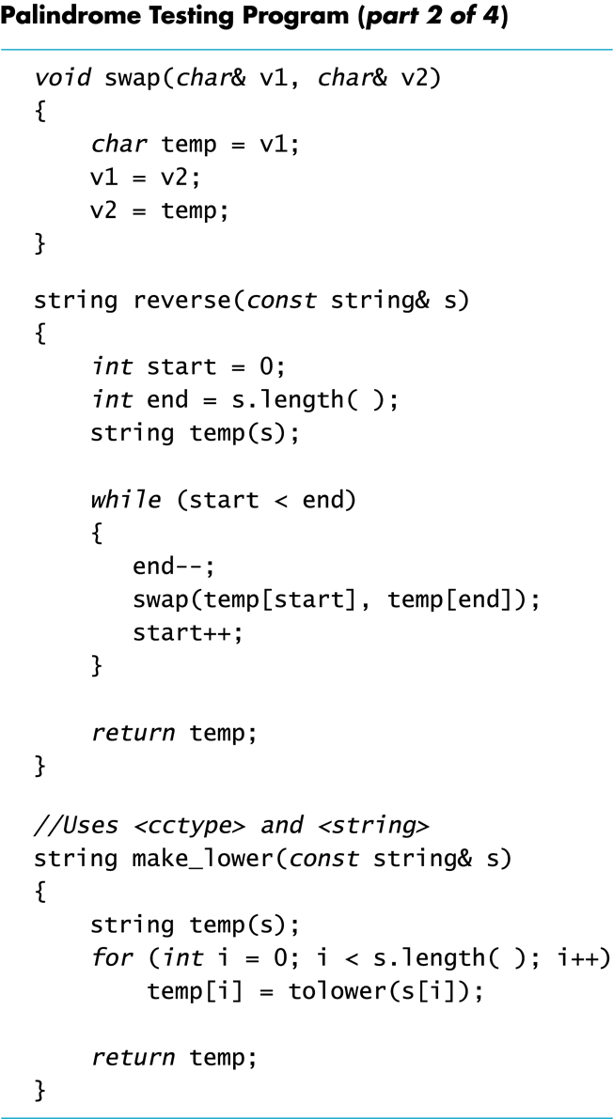
Display 8.8 (2/4)
Back
Next

Slide 91
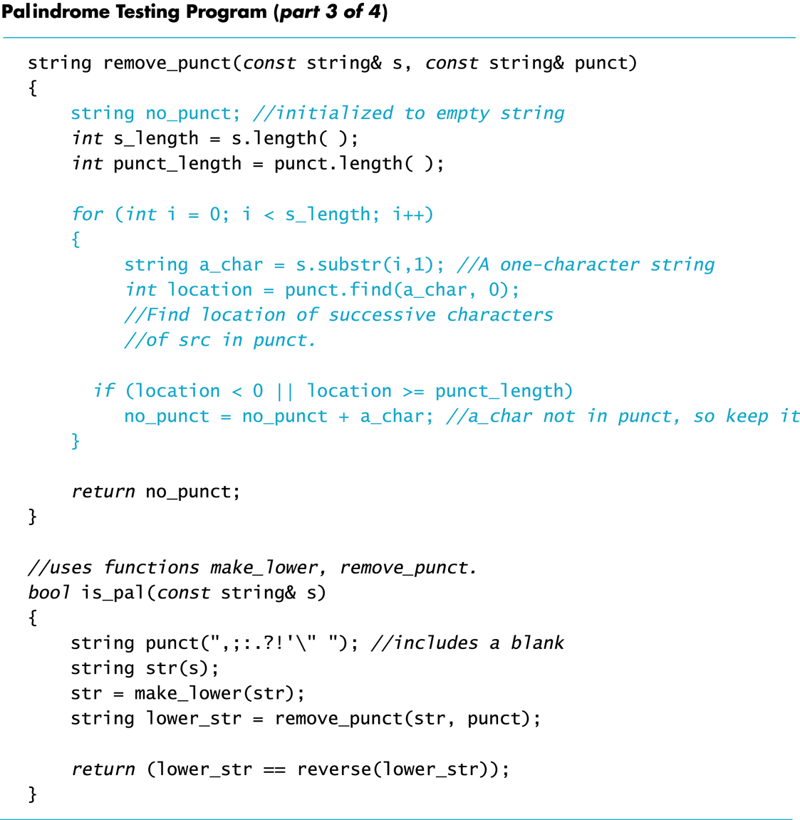
Display 8.8 (3/4)
Back
Next

Slide 92
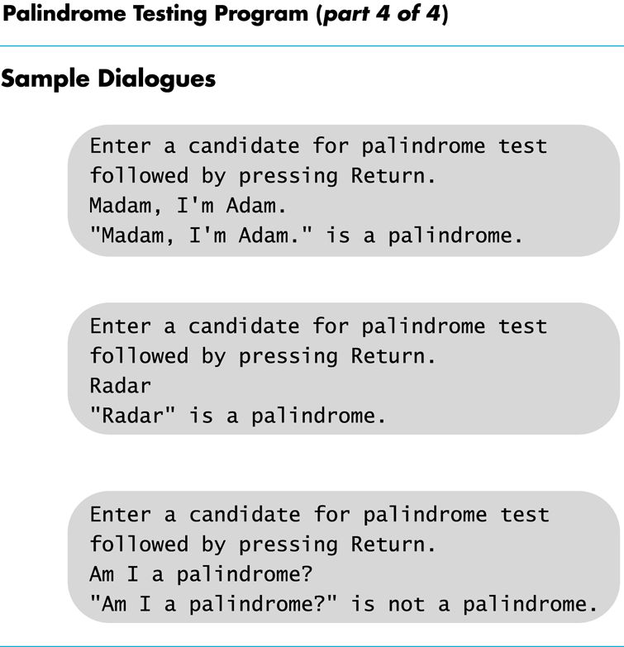
Display 8.8 (4/4)
Back
Next

Slide 93
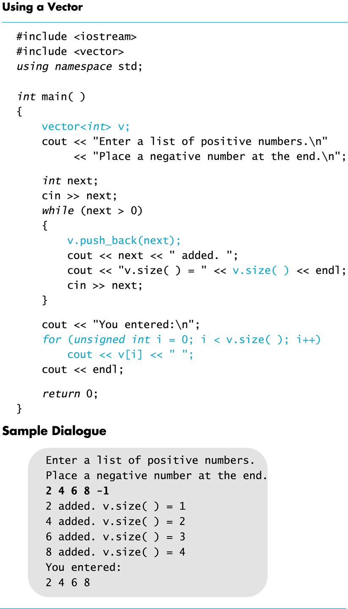
Display 8.9
Back
Next

